Slide 1

Real Time Driver Drowsiness Detection
Research paper :- Real-Time Driver Drowsiness Detection System Using Eye Aspect Ratio, Eye Closure AND Blink distance by Jaypee Institute Of Information Technology published on (2019).
BY:
K.Lalith Kumar BL.EN.U4CSE17068
M.L.Kruthik BL.EN.U4CSE17077
K.Rakesh BL.EN.U4CSE17054
S.Dinesh Reddy BL.EN.U4CSE17118

Slide 2
INTRODUCTION
One of the major causes behind the casualties of people in road accidents is driver’s drowsiness. After continuous driving for long time, drivers easily get tired resulting into driver fatigue and drowsiness
Statistics
The Drowsiness of driver detection system is developed to reduce this type of accidents.
This detection is done for the drivers based on the EAR (Eye Aspect Ratio) and ECR (Eye Closure Ratio) and Blink distance.

Slide 3
CHALLENGES AND RESEARCH GAP
The most significant challenge is that there cannot be any reflective object behind the driver. The more uniform the background is, the more robust the system becomes.
For testing, rapid head movement was not allowed, since it can be equivalent to simulating a tired driver
When the head is turned too much sideways there were some false alarms.
Due to poor illumination the system may lose track on the vector points of Eye which leads to the change in EAR , ECR,Blink Distance.

Slide 4
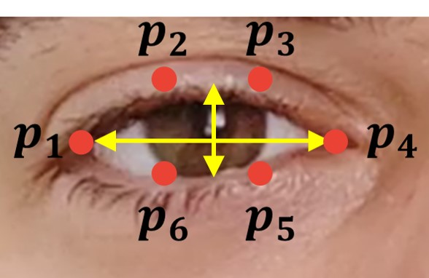
Proposed Methodology
By having the points shown in the figure the EAR(Eye Aspect Ratio) is calculated and the EAR will be set as 0.25 as threshold.If the computed EAR is less than the threshold EAR then there will be a sleep counter variable and it will be incremented and there will be a total counter variable where, it counts the number of frames for which it had calculated the EAR value.

Slide 5
EAR = ( |p2 – p6| +|p3 – p5|)/(2*|p1-p4|)
Eye blink in general lasts from 150 to 300ms
Blink distance=Distance between((p2+p3)/2,(p6+p5)/2)
ECR will be calculated for every 15 frames.
ECR = (Sleep counter / Total Counter).

Slide 6
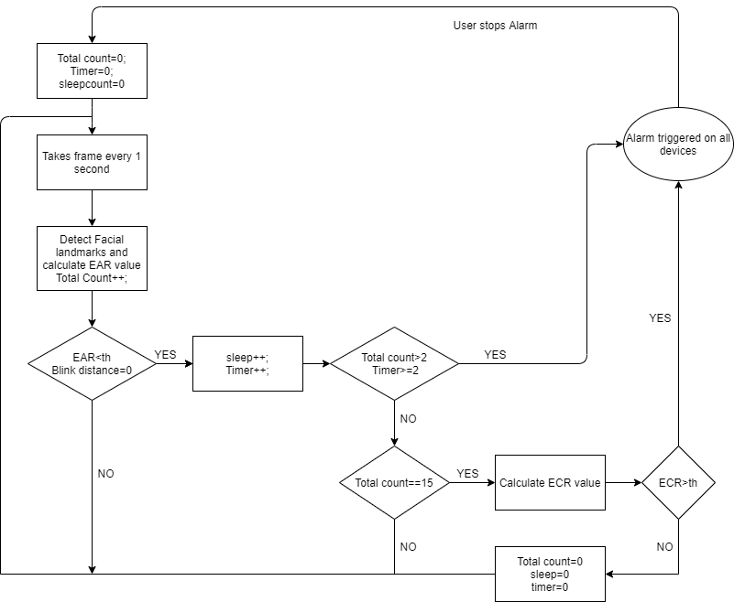

Slide 7
Implementation
Firstly, System will get the real time video feed of the driver.
It Computes EAR and checks with the threshold value provided. At the same time it calculates the blink distance.
It Make changes to the counters and computes the ECR value
Then the system will give the appropriate alert messages.

Slide 8
Improvements and Modifications
For even more accuracy we can use other algorithms like HOG(Histograms of oriented gradients) to calculate the EAR value more accurately..But it is not so good in analysing small faces.and we can even use Haar Cascade classifier
We can even use Mouth Opening Ratio as a parameter to detect yawning during drowsiness for better accuracy.
We can develop a android application which helps taxi companies like Uber,Ola,Lyft etc.

Slide 9
Literature Survey
[1] A. Rahman, M. Sirshar and A. Khan, "Real time drowsiness detection using eye blink monitoring," 2015 National Software Engineering Conference (NSEC), Rawalpindi, 2015, pp. 1-7, DOJ: 10.1109/NSEC.2015.7396336.
[2] Danisman, Taner & Bilasco, Ioan Marius & Djeraba, Chaabane & Ihaddadene, Nacim. (2010).” Drowsy driver detection system using eye blink patterns”. 2010 International Conference on Machine and Web Intelligence, ICMWI 2010 - Proceedings. 10.1109/ICMWI.2010.5648121.
[3] V. Varghese, A. Shenoy, S. Ks, and K. P. Remya, “Ear Based Driver Drowsiness Detection System,” vol. 2018, pp. 93–96, 2018.
[4] S. Junawane, S. Jagtap, P. Deshpande, and L. Soni, “Driver Drowsiness Detection Techniques :,” vol. 6, no. 11, pp. 2015–2017, 2017.

Slide 10
INDIVIDUAL CONTRIBUTIONS
NAME | CONTRIBUTION
K.Lalith | Getting the video feed of the driver and calculating EAR.
M.L.Kruthik | Getting video feed of the driver and calculating EAR
S.Dinesh | Getting video feed of the driver and calculating Blink distance
K.Rakesh | Making changes to the counter values and Calculate the ECR

